Slide 1
Course 2 Module 5 Programming Assignment Assignment: ETL MIMIC data into the OMOP CONDITION_OCCURRENCE table

Slide 2
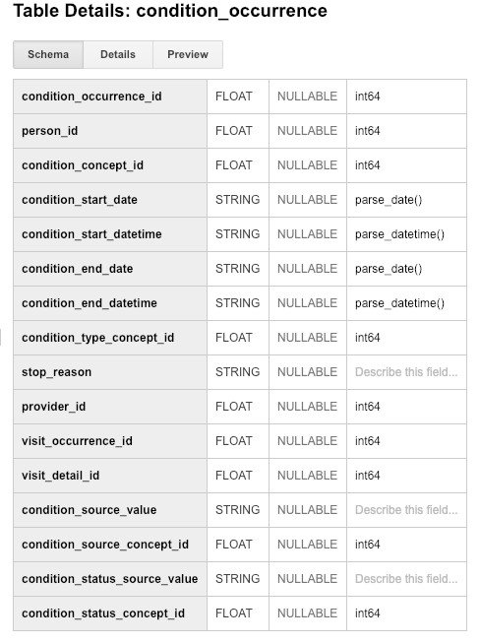
Step 1: Understand source/target data models
OMOP Table - Target
A foreign key identifier to the Person who is experiencing the condition. The demographic details of that Person are stored in the PERSON table.
The source code for the Condition as it appears in the source data. This code is mapped to a Standard Condition Concept in the Standardized Vocabularies and the original code is stored here for reference.
A foreign key to the visit in the VISIT_OCCURRENCE table during which the Condition was determined (diagnosed).
Notes:
Defining the target information for understanding.

Slide 3
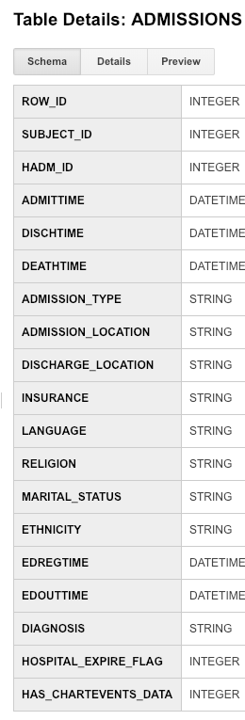
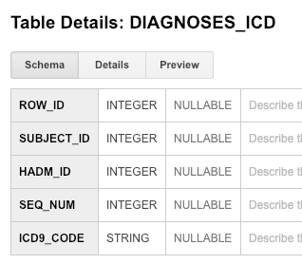
Step 1: Understand source/target data models
MIMIC Tables
OMOP Table
Notes:
ADMISSIONS TABLE
SUBJECT_ID: is a unique identifier which specifies an individual patient
HADM_ID: represents a single patient’s admission to the hospital
DIAGNOSIS: provides a preliminary, free text diagnosis for the patient on hospital admission. (Final diagnoses for a patient’s hospital stay are coded on discharge and can be found in the DIAGNOSES_ICD table. While this field can provide information about the status of a patient on hospital admission, it is not recommended to use it to stratify patients.)
DIAGNOSES_ICD TABLE
ICD9_CODE: contains the actual code corresponding to the diagnosis assigned to the patient for the given row

Slide 4
Step 2: Profile source table or tables
MIMIC ADMISSIONS – 19 fields
SUBJECT_ID
Integer
Max length = 5
A subject ID may be seen multiple times as a single patient can have multiple admissions. This is why the subject ID frequency can be greater than 1.
HADM_ID
Ingeter
Max length = 6
Each HADM_ID corresponds to 1 SUBJECT_ID, but could have multiple diagnoses codes.
MIMIC DIAGNOSES_ICD – 5 fields
ICD-9
Variable Characters
Max length = 5
Each SUBJECT_ID and HADM_ID may have multiple diagnoses.
Notes:
ADMISSIONS TABLE
SUBJECT_ID: is a unique identifier which specifies an individual patient
HADM_ID: represents a single patient’s admission to the hospital
DIAGNOSIS: provides a preliminary, free text diagnosis for the patient on hospital admission. (Final diagnoses for a patient’s hospital stay are coded on discharge and can be found in the DIAGNOSES_ICD table. While this field can provide information about the status of a patient on hospital admission, it is not recommended to use it to stratify patients.)
DIAGNOSES_ICD TABLE
ICD9_CODE: contains the actual code corresponding to the diagnosis assigned to the patient for the given row

Slide 5
Step 3: Create ETL mappings
Using the MIMIC ADMISSIONS table we can capture ‘person_id’ using the MIMIC SUBJECT_ID as these fields both represent the patient diagnosed with the condition.
Using the MIMIC ADMISSIONS table we can capture the ‘visit_occurence_id’ using the MIMIC HADM_ID as these fields both represent the visit for which the diagnoses are attributed to for the patient.
We do not use the MIMIC DIAGNOSIS field here as this is a preliminary, free text diagnosis upon admission and not the true representation of the final diagnoses.
Notes:
Condition records are typically inferred from diagnostic codes recorded in the source data. Such code systems, like ICD-9-CM, ICD-10-CM, Read etc., provide a comprehensive coverage of conditions. However, if the diagnostic code in the source does not define a condition, but rather an observation or a procedure, then such information is not stored in the CONDITION_OCCURRENCE table, but in the respective tables indicated by the domain.
ADMISSIONS TABLE
SUBJECT_ID: is a unique identifier which specifies an individual patient
HADM_ID: represents a single patient’s admission to the hospital
DIAGNOSIS: provides a preliminary, free text diagnosis for the patient on hospital admission. (Final diagnoses for a patient’s hospital stay are coded on discharge and can be found in the DIAGNOSES_ICD table. While this field can provide information about the status of a patient on hospital admission, it is not recommended to use it to stratify patients.)

Slide 6
Step 3: Create ETL mappings
Using the MIMIC DIAGNOSES_ICD table we can capture the ‘condition_source_concept_id’ using the MIMIC ICD9_CODE as these fields both represent diagnoses attributable to the patient on a given visit. This field in the ‘condition_occurence’ table utilizes the source code as it appears in the source data. Within OMOP source Condition identifiers are mapped to Standard Concepts for Conditions in the Standardized Vocabularies. The MIMIC ICD9_CODE utilizes ICD-9 coding, which is a standard code set and already included within the OMOP and can be directly mapped to the Vocabulary table. So there is not a need to use the MIMIC D_ICD_DIAGNOSES to map concepts.
Notes:
DIAGNOSES_ICD TABLE
ICD9_CODE: contains the actual code corresponding to the diagnosis assigned to the patient for the given row
A Condition Occurrence Type is assigned based on the data source and type of condition attribute, for example: ICD-9-CM Primary Diagnosis from inpatient and outpatient claims
ICD-9-CM Secondary Diagnoses from inpatient and outpatient claims
Diagnoses or problems recorded in an EHR.
There is one record for each Vocabulary. One Vocabulary source or vendor can issue several Vocabularies, each of them creating their own record in the VOCABULARY table. However, the choice of whether a Vocabulary contains Concepts of different Concept Classes, or when these different classes constitute separate Vocabularies cannot precisely be decided based on the definition of what constitutes a Vocabulary. For example, the ICD-9 Volume 1 and 2 codes (ICD9CM, containing predominantly conditions and some procedures and observations) and the ICD-9 Volume 3 codes (ICD9Proc, containing predominantly procedures) are realized as two different Vocabularies. On the other hand, SNOMED-CT codes of the class Condition and those of the class Procedure are part of one and the same Vocabulary. Please refer to the Standardized Vocabularies specifications for details of each Vocabulary.

Slide 7
Step 4: Write transformation code
WITH occurrence1 as (select distinct mo.subject_id as person_id from mimic3_demo.ADMISSIONS mo),
occurrence2 as (select distinct o1.person_id, mo.hadm_id as visit_occurrence_id
from occurrence1 o1 join mimic3_demo.ADMISSIONS mo on o1.person_id = mo.subject_id),
occurrence as (select distinct o2.person_id, o2.visit_occurrence_id
,mo.icd9_code as condition_source_concept_id
from occurrence2 o2 join mimic3_demo.DIAGNOSES_ICD mo on o2.visit_occurrence_id = mo.hadm_id)
Select * from occurrence

Slide 8
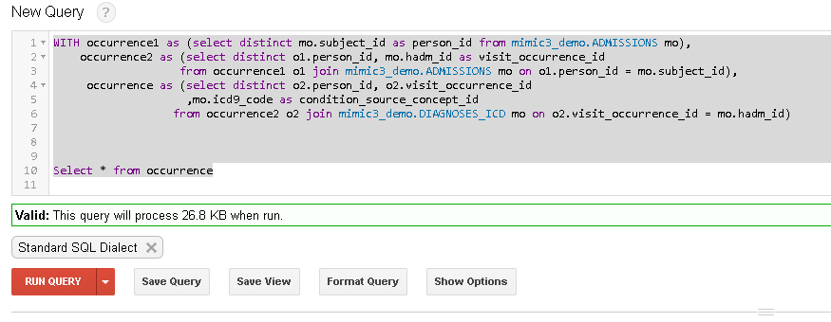
Step 5: Execute transformation code

Slide 9
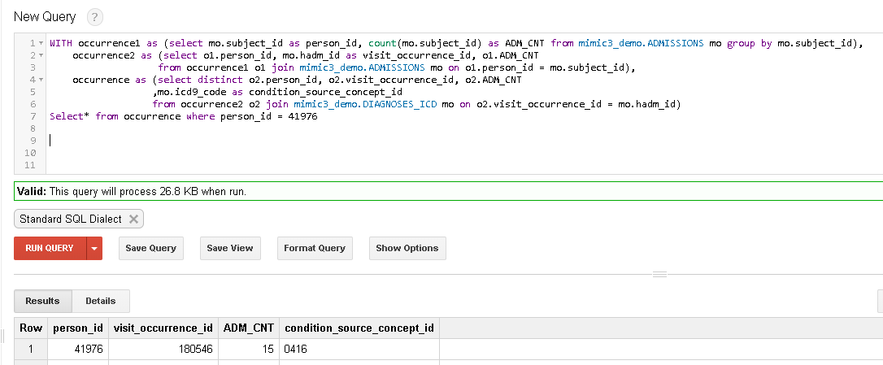
Step 6: Perform data quality assessment
The White Rabbit output showed that SUBJECT_ID 41076 had 15 separate admissions. The above query shows that this is reflected in the new ‘occurrence’ table.
Notes:
WITH occurrence1 as (select mo.subject_id as person_id, count(mo.subject_id) as ADM_CNT from mimic3_demo.ADMISSIONS mo group by mo.subject_id),
occurrence2 as (select o1.person_id, mo.hadm_id as visit_occurrence_id, o1.ADM_CNT
from occurrence1 o1 join mimic3_demo.ADMISSIONS mo on o1.person_id = mo.subject_id),
occurrence as (select distinct o2.person_id, o2.visit_occurrence_id, o2.ADM_CNT
,mo.icd9_code as condition_source_concept_id
from occurrence2 o2 join mimic3_demo.DIAGNOSES_ICD mo on o2.visit_occurrence_id = mo.hadm_id)
Select* from occurrence where person_id

Slide 10
Step 7: Package documentation
See content and notes in previous slides

Slide 11
Appendix: Source Code
SQL Source Code for Mappings
WITH occurrence1 as (select distinct mo.subject_id as person_id from mimic3_demo.ADMISSIONS mo),
occurrence2 as (select distinct o1.person_id, mo.hadm_id as visit_occurrence_id
from occurrence1 o1 join mimic3_demo.ADMISSIONS mo on o1.person_id = mo.subject_id),
occurrence as (select distinct o2.person_id, o2.visit_occurrence_id
,mo.icd9_code as condition_source_concept_id
from occurrence2 o2 join mimic3_demo.DIAGNOSES_ICD mo on o2.visit_occurrence_id = mo.hadm_id)
Select * from occurrence
SQL Source Code for Quality Measure
WITH occurrence1 as (select mo.subject_id as person_id, count(mo.subject_id) as ADM_CNT from mimic3_demo.ADMISSIONS mo group by mo.subject_id),
occurrence2 as (select o1.person_id, mo.hadm_id as visit_occurrence_id, o1.ADM_CNT
from occurrence1 o1 join mimic3_demo.ADMISSIONS mo on o1.person_id = mo.subject_id),
occurrence as (select distinct o2.person_id, o2.visit_occurrence_id, o2.ADM_CNT
,mo.icd9_code as condition_source_concept_id
from occurrence2 o2 join mimic3_demo.DIAGNOSES_ICD mo on o2.visit_occurrence_id = mo.hadm_id)
Select* from occurrence where person_id = 41976

